Slide 1
Shareable Metadata for Visual Resources
Jenn Riley
Metadata Librarian
Indiana University Digital Library Program

Slide 6
What does this record describe?
<dc:title>Bowie County Texas (County Number 19, Supplementary Sheet D)</dc:title>
<dc:creator>Texas Transportation Planning and Programming Division.</dc:creator>
<dc:subject>Texarkana</dc:subject>
<dc:subject>Kennedy Lake</dc:subject>
<dc:subject>Coca Cola Lake</dc:subject>
<dc:subject>Hobo Jungle Park</dc:subject>
<dc:publisher>The General Libraries, University of State</dc:publisher>
<dc:identifier>http://library.university.edu/raw/tcbowid1.html</dc:identifier>
Record harvested via OAI PMH 2-26-2007

Slide 7
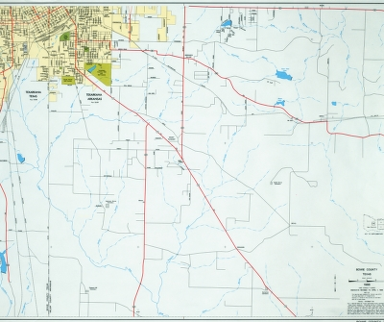

Slide 8
And this one?
<dc:identifier>http://museum.university.edu/unique identifier</dc:identifier>
<dc:publisher>State University Museum of Ichthyology, Fish Field Notes</dc:publisher>
<dc:format>jpeg</dc:format>
<dc:rights>These pages may be freely searched and displayed. Permission must be received for subsequent distribution in print or electronically. Please go to http://museum.university.edu/ for more information.</dc:rights>
<dc:type>image</dc:type>
<dc:description>1926; 0070; 06; Little S. Br. Pere Marquette R.; THL26-68; 71300; 71301; 71302; 71303; 71304; 71305; 71306; 71307; 71308; 71309; 07; 1926/07/06; R12W; S09; Second collector Moody; T16N</dc:description>
<dc:subject>Cottus bairdi; Esox lucius; Cottus cognatus; Etheostoma nigrum; Salmo trutta; Oncorhynchus mykiss; Catostomus commersoni; Pimephales notatus; Margariscus margarita; Rhinichthys atratulus; mottled sculpin; northern pike; slimy sculpin; johnny darter; brown trout; rainbow trout; white sucker; bluntnose minnow…</dc:subject>
<dc:language>UND</dc:language>
<dc:source>Michigan 1926 Langlois, v. 1 1926--1926; </dc:source>
Record harvested via OAI PMH 2-27-2007

Slide 9
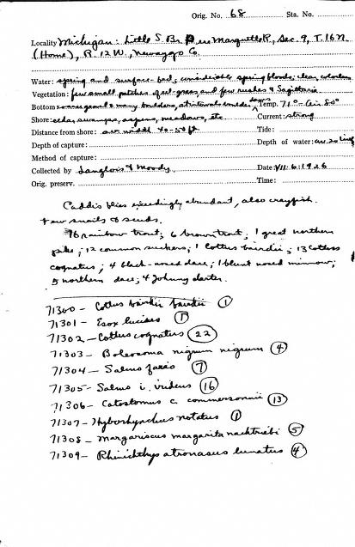

Slide 10
Why Share?
Sharing benefits users
One-stop searching (maybe)
Ability to create customized searches of specific domains
Brings together distributed collections
Sharing benefits your institution
Increases exposure of collections
Broadens user base
Potentially adds collaboration opportunities
We can no longer assume that users will come through the front door—sharing metadata gets us “in the flow”
Thinking about sharing now will help your future system migration

Slide 11
Sharing allows our users to help us

Slide 12
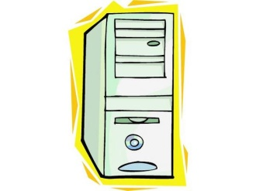
Sharing metadata: Federated search
The distributed databases are searched directly.
<title>My resource</title> <date>04
Mill?
<title>My resource</title> <date>04
<title>My resource</title> <date>04
For Example:
Z39.50, SRU

Slide 13
Sharing metadata: Data aggregation
The user searches a pre-aggregated database of metadata from diverse sources.
Mill?
<title>My resource</title> <date>04
For Example: Search engines, union catalogs, OAI PMH, RSS

Slide 14
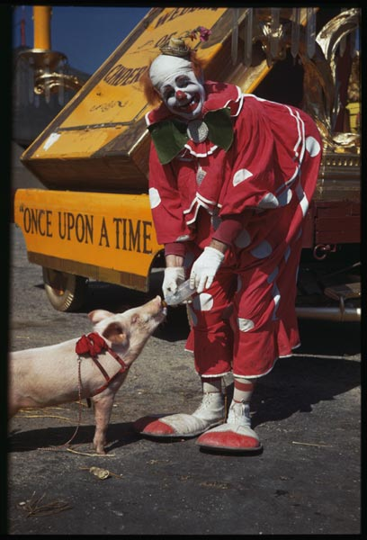
?????
Collection Registries
Photograph from Indiana University Charles W. Cushman Collection

Slide 15
Shareable Metadata…
Is quality metadata
Promotes search interoperability - “the ability to perform a search over diverse sets of metadata records and obtain meaningful results” (Priscilla Caplan)
Is human understandable outside of its local context
Is useful outside of its local context
Preferably is machine processable

Slide 16
Shareable Metadata as a View
Metadata is not monolithic
Metadata should be a view projected from a single information object
Create multiple views appropriate for groups of important sharing venues
Depends on:
Use
Audience

Slide 17
The Cs & Ss of Shareable Metadata
Content
Coherence
Context
Communication
Consistency
Conformance to
Standards

Slide 18
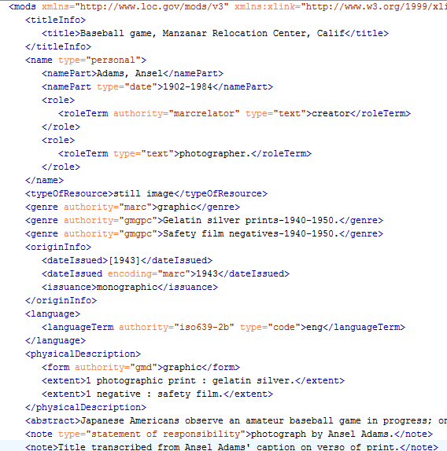
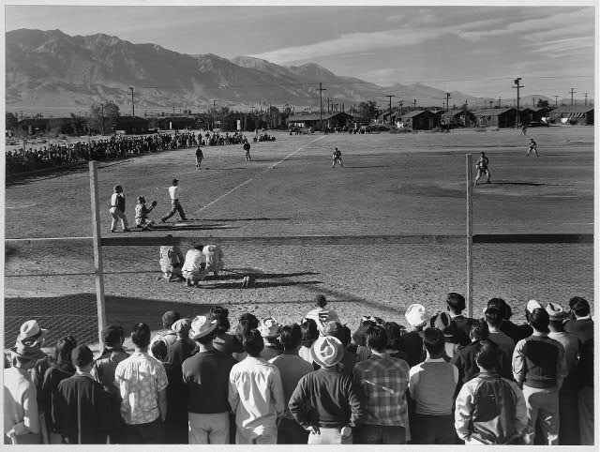
LC MODS Record for Adams Image

Slide 19
Special Sharing Challenges for the VR Community
Documentary approach vs. art approach to description
Work vs. Image distinction
Original works vs. copies
De-duplication is hard!
OAI-PMH data providers not available in most commonly-used systems
Many VR professionals don’t have access to a great deal of institutional IT support
Need sharing for both end-user access and copy cataloging
UCAI effort uncovered many of these challenges, and others
Look for more ways to try, regardless!

Slide 20
Basic metadata sharing workflow
Plan
Transform
Choose standards for native metadata
Perform conceptual mapping
Create
Share
Assess
Who to share with?
Implement sharing protocol
See who is collecting your metadata
Perform technical mapping
Create metadata (thinking about shareability)
Communicate with aggregators
Review your metadata in aggregations
Choose shared metadata formats
Validate transformed metadata
Write metadata creation guidelines
Test shared metadata with protocol conformance tools

Slide 21
Three possible OAI-PMH workflows
Digital asset management system
QDC
MODS
Metadata creation module
OAI data provider module
Transformation
DC
MARCXML
Metadata creation module
Static Repository Gateway
OAI Harvester
Transformation
QDC
MODS
Metadata creation system
Stand-alone OAI data provider
Transformation
DC
MARCXML

Slide 22
Thank you!
Questions?
For more information:
jenlrile@indiana.edu
These presentation slides: <http://www.dlib.indiana.edu/~jenlrile/presentations/ vra2010/rileyVRA2010.pptx>
Shreeves, Sarah L., Jenn Riley, and Liz Milewicz. "Moving towards shareable metadata." First Monday 11, no. 8 (7 August 2006). <http://firstmonday.org/htbin/cgiwrap/bin/ojs/index.php/ fm/article/view/1386/1304>

