Slide 1
New roles for library metadata
Jenn Riley
Head, Carolina Digital Library and Archives The University of North Carolina at Chapel Hill

Slide 2
Remix culture

Slide 3
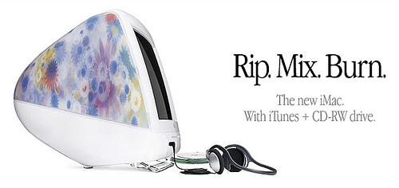

Slide 4
Read/Only culture
Read/Write culture

Slide 5
Libraries must acknowledge support for both RO and RW.

Slide 6
A redefined role for libraries, and our metadata

Slide 7
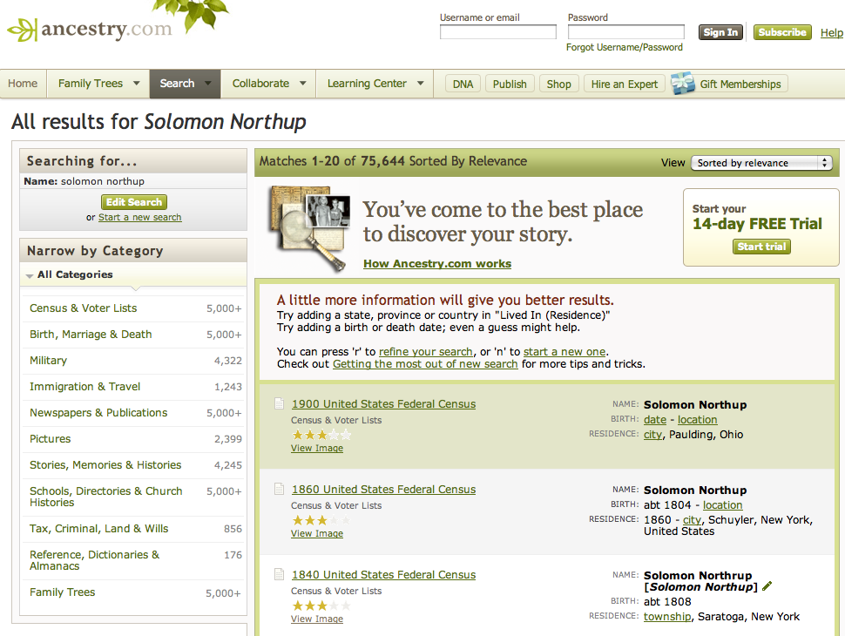
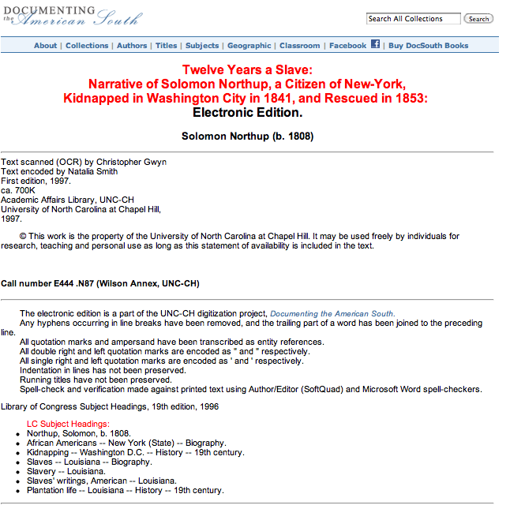
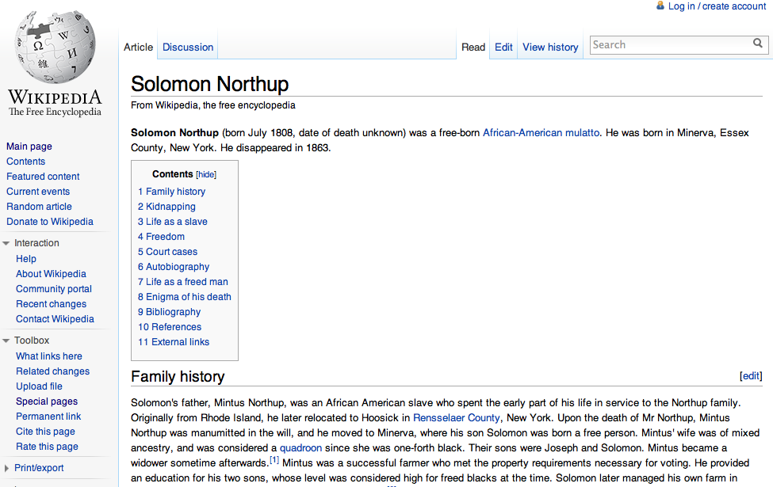

Slide 8
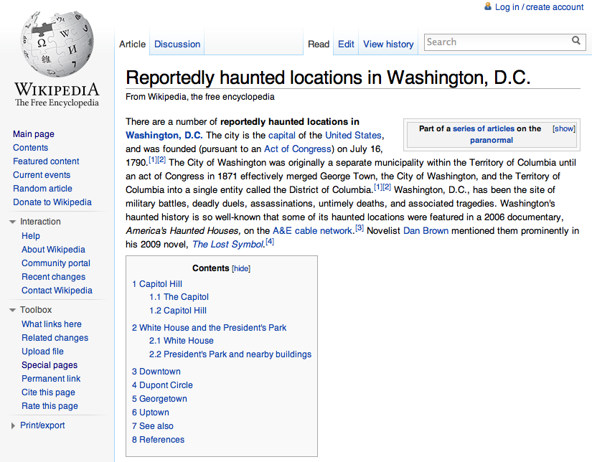
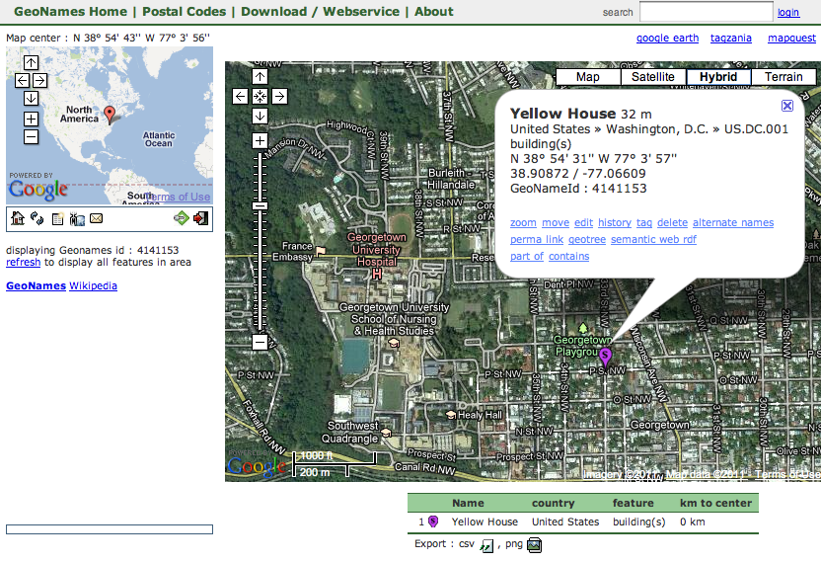

Slide 9
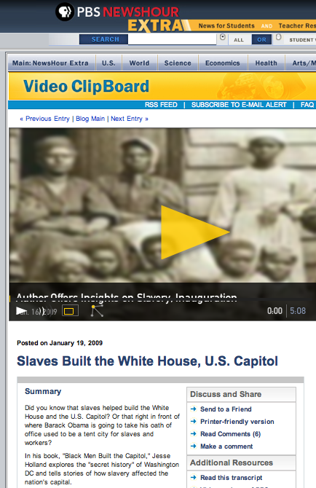
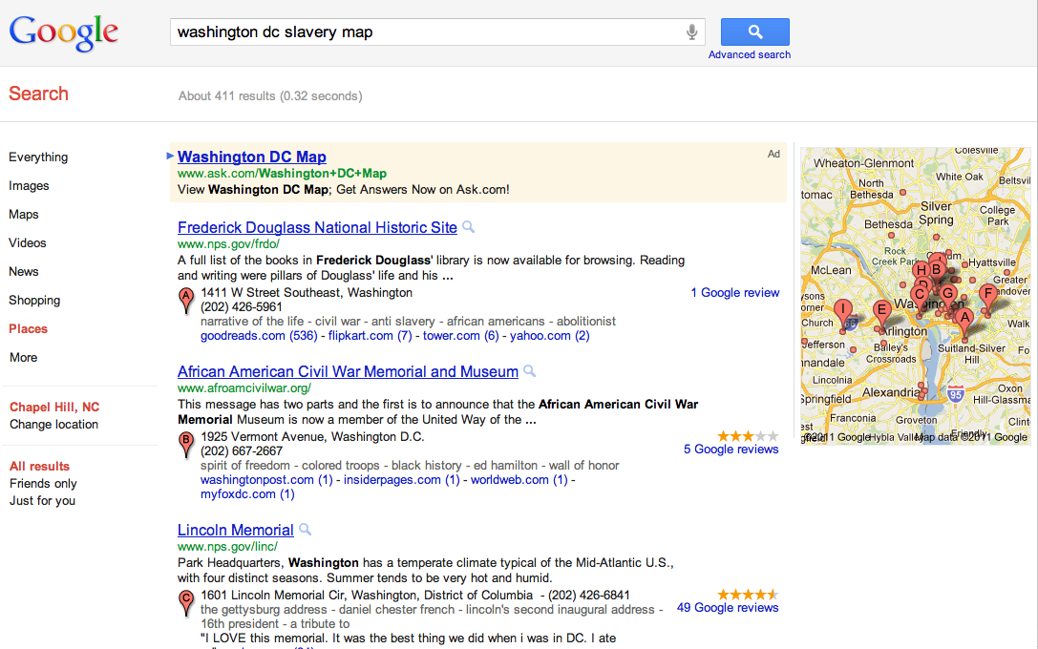
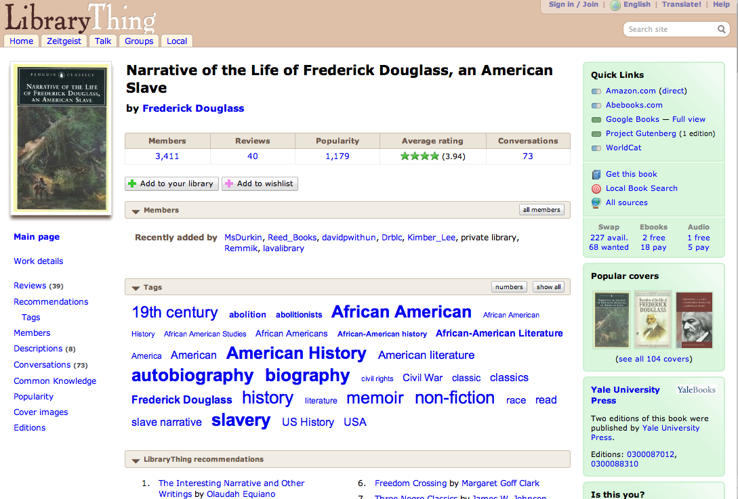

Slide 10
Really? That’s scary.

Slide 11
Cutter: Objects of the Catalog
To enable a person to find a book of which either
the author
the title
the subject
To show what the library has
by a given author
on a given subject
in a given kind of literature
To assist in the choice of a book
as to its edition (bibliographically)
as to its character (literary or topical)
}
is known

Slide 12
Don’t be limited

Slide 13
Library missions are broad
ALA Strategic Plan 2010-2015
ALA provides leadership in the transformation of libraries and library services in a dynamic and increasingly global digital information environment.
Big Audacious Goal:
ALA builds a world where libraries, both physical and virtual, are central to life-long discovery and learning and where everyone is a library user.
Libraries collaborate effectively with each other, with museums, archives and other information providers to increase public access to information.

Slide 14
Interpreting that mission

Slide 15
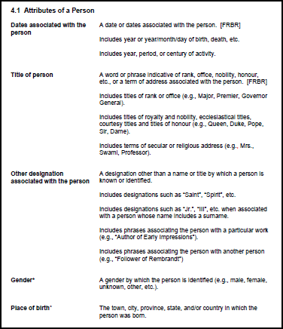
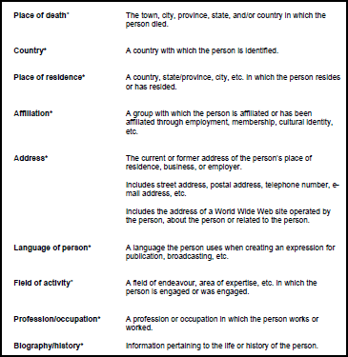
A broad view of library metadata

Slide 16
So how do we pay for all of this?

Slide 17
No more copy cataloging

Slide 18
Give up control of some of the details

Slide 19
Use technology more effectively

Slide 20
This is going to take a while

Slide 21
Thank you!
jennriley@unc.edu
CC BY-SA 3.0
Fractal image by Jon Zander (Digon3)
http://commons.wikimedia.org/wiki/File:Lines_Apophysis_Fractal_Flame.jpg

