Slide 1
Competing Priorities: Sustainability, Growth, and Innovation In Digital Collections
Jenn Riley
Head, Carolina Digital Library and Archives
University of North Carolina at Chapel Hill
Notes:
We’re all familiar with this problem. It often feels intractable.
I’ll describe some strategies UNC Library is using to move forward in these areas, primarily as they relate to digital collections, digital libraries, and library technology.

Slide 2
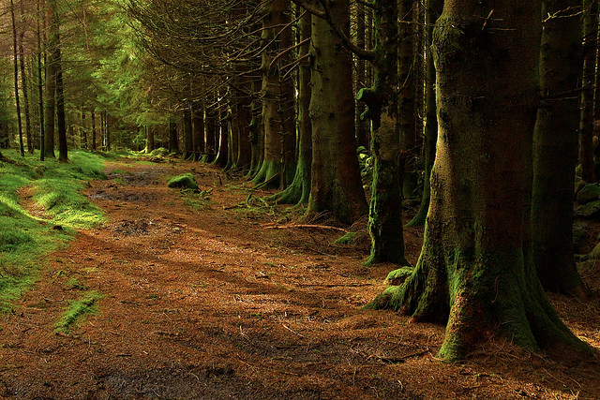
Are academic libraries like a forest?
Photo by erwlas. http://www.flickr.com/photos/erwlas/3216477632/
Notes:
I hope we can find this metaphor useful for our purposes today.
The forest itself grows, changes over time. It’s a long-term operation; a set of inter-related organisms (initiatives) that are distinct to a degree but part of a larger functioning ecosystem.
There are some very different types of things living and happening in the forest – both plants and animals. In libraries we have services and collections for undergrads, and services and collections for graduate students and faculty. We have (to use a traditional breakdown) reference, cataloging, collection development, information technology. These functions all work together in the library ecosystem.
Individual parts of the forest change over time. Both plants and animals evolve and adapt to conditions around them. Outside influences—campers, a road, loggers, migrating birds, animals displaced from elsewhere seeking refuge—cause additional and often more rapid changes. So too with the library.
The forest as a whole grows over time within its capabilities, and stops expanding at natural barriers. Individual parts of the forest have their own growth as well—trees begin as seedlings and compete with others nearby for resources and room to grow. One can see similar patterns in academic libraries in general, and specific initiatives within them, over time.

Slide 3
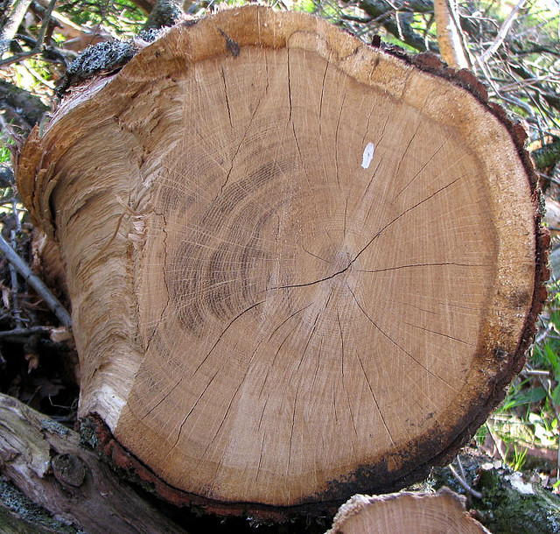
How can we manage growth?
Photo by aislinv. http://www.flickr.com/photos/aislinnv/446429071/
Notes:
The growth of digital collections presents us with an enormous challenge. We’ve grown in terms of the number of digital objects we manage overall, in the number of curated digital collections we present online, and introduced large scale digitization operations for both printed and manuscript materials.
UNC DPC – 1.7 million digital files in 2011
(130,473 + 238,530 + 1,339,166)
This doesn’t include digital audio/video production, but it does include IA Scribe.
Growth of “projects” too, which is the reason for “project to program” shifts in digital libraries. This shift needs to account for both technology and services. We’ll speak more about this later.
But digital collections aren’t the only thing that’s growing in libraries. Even if we keep our analysis related to technology (though there’s certainly ample similar issues in other areas of libraries), we have ILSs plus discovery layers, multiple database platforms, multiple calendaring systems, ever increasing ebook platforms, expansion of mobile access… we could spend our entire time on this list.
And there’s only so much to learn about managing this growth from the analog world. Planning for new buildings, offsite storage, new degree programs, and responding to new needs within fixed collections budgets do have some lessons for us, but we’re also facing fundamentally new challenges related to the need to actively manage digital content in order to preserve it, and a host of other additional issues.

Slide 4
How can we manage change?
Photo by Nemo’s great uncle. http://www.flickr.com/photos/maynard/75485033/
Notes:
Growth and change go hand in hand. We’re pretty used to the idea that it’s clearly within our mission to digitize and put online our analog collections by now. But we can’t rest on this success. More change is here, and even more is coming.
Interdisciplinarity, globalization, and license over purchase models are three among the many factors influencing how libraries are approaching our work on the large scale. In the area in which I focus, fundamental changes in scholarly communications mechanisms are influencing us. “Digital libraries” have moved far beyond the boutique collections of the late 90s and early 2000s, and departments like mine need to adapt. Large scale digitization has opened up new possibilities for ways of working. The digital humanities as a disciple is still going strong and even growing, but is not just about TEI markup and scholarly editions any more. Data on a large scale is also transforming our work – its processing, preservation, and distribution.
This is where the field is. It’s no surprise to any of you. Let’s look to UNC now, and I’ll share where we are, and some steps we’ve been taking over the last 18 months to address these issues.

Slide 5
A familiar story (broadly told)
Administration’s perspective: We need a fundamental change.
Front line librarians’ perspective: We’re moving too slowly; I can’t get the resources I need to follow through on my ideas.
Technical staff’s perspective: We can’t take on any more.
Notes:
I’ll cover our work to move past this in terms of Systems, Services, and Process

Slide 6
THE SYSTEMS
Basic premise: A well-planned, integrated set of software systems to support digital library work is the core of technical sustainability, and allows manageable growth and innovation.

Slide 7
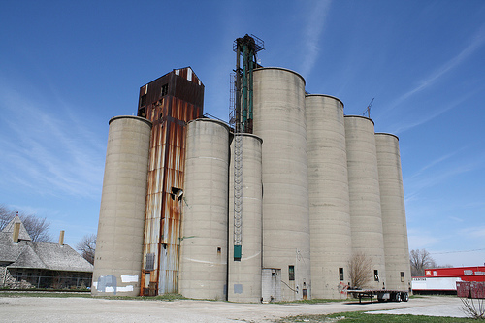
Yep, we have this problem.
Photo by windsordi. http://www.flickr.com/photos/windsordi/3467758700/
Notes:
At UNC, we grew our digital library and repository efforts in many different ways, across different departments and with different technologies. Work has been done in a strong project-centric way. Clearly we can’t continue that. But HOW can we fix it? What’s the right programmatic way forward?
A bigger, more uniform silo isn’t the solution. A fundamental change in how we view, and build, digital “collections” is in order.

Slide 8
What if it were more like this?
Photo by James UK. http://www.flickr.com/photos/jamesuk/503466376/
Notes:
I was at a meeting a few weeks ago envisioning metadata strategy for the four Triangle Research Libraries Network institutions. We were discussing the metadata silos that we all have, and noting that treating everything the same wasn’t the answer either. The Head of Technical Services at UNC came up with an apt metaphor – that what we need is not a silo, but a sieve.
We need to use large scale, basic digitization approaches as a foundation, and then allow, when appropriate, and only for a subset of material, more curated collections to be built upon these, and not separate from them. We also need to open ourselves up to others building those collections, in their own context.
Still some value in curated collections. We’re still figuring out what our optimal balance is. But recent data collection supports some effort in support of these. We’re still seeking to better understand the data we’re collecting, but have some early indications that return visits, time on site, and views per item are all positively affected by an in-context presentation. Clearly we have more work to do in this area to understand the impact of this treatment on use of our digital materials.

Slide 9
PUBLIC-FACING TOOLS
INTERNALLY-FOCUSED TOOLS
Discovery/delivery layer
UNC-MANAGED SYSTEMS
EXTERNALLY-MANAGED SYSTEMS
über discovery system
Specialized discovery/delivery system
Specialized content management& access systems
Specialized content management & access systems
Access control
Metadata/object management interface
Management/access layer
Collection builder tool
Metadata creation tools
etc.
Scalable image delivery
Streaming media
Middleware services
Ingest prep
ID resolution
Object normalization/transformation
Ingest (add/update/delete/normalize content/metadata)
Ingest (add/update/delete/normalize content/metadata)
Abstraction services for repository communication
Indexing
Storage/preservation layer
Access control
Metadata
Preservation masters
Access copies
Preservation services
Other object repositories with cool stuff
Standard communication protocol or syndication of content
Services
Web applications, with user interfaces. May cache data.
External repositories to which UNC contributes content
Storage
Notes:
Here’s an early version of our plan. We’re not completely committed to this yet, but have been discussing it for a year or so.
We don’t need to review all of the details. Some salient ones:
Modular – this is the way things are going.
Flexible for the future – use existing packages, swap out when needed. See a medium term future where we’re all in constant migration, and just have to deal with that fact.
Tools talk to each other, can all expose data out to our tools or others
Many storage options – match to the need
Capability to preserve everything, though wouldn’t do so; would instead preserve by policy rather than opportunity
Ability to re-use digital objects in multiple ways, multiple user-facing “collections”
Lots of discovery systems, including the catalog
Would ideally like to piggyback on content availability in places like HathiTrust
“collection builder” tools – lower the investment to putting up a curated collection. Don’t’ make them individually written webapps but run inside an environment that is designed to allow subsetting/somewhat customized presentation. Starting an Omeka pilot this spring.

Slide 10
It’s a goal. Something to work towards.
Photo by Eddie van W. http://www.flickr.com/photos/spiritual_marketplace/2207966935/
Notes:
I know, I know – keep dreaming, Jenn!
As I mentioned, we’re not committed to this exact setup yet, but we do see a more modular but integrated architecture as the way to go.
For now, we’re comfortable with just using this general idea as an influence for specific decisions we make, like an Omeka pilot. Soon we may move to explicitly prioritizing initiatives that use or help to build this, or migrate legacy content into it and allow us to retire one of our silos.

Slide 11
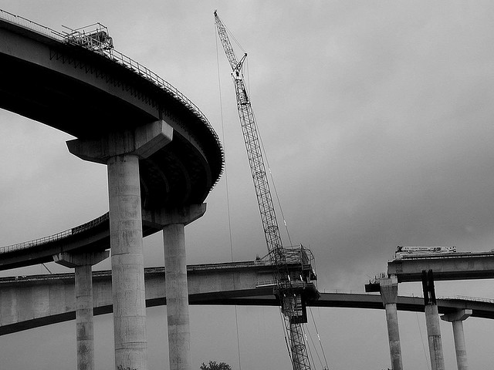
Photo by Alex R. (rt48state). http://www.flickr.com/photos/rt48state/3756762770/
Notes:
We have long term plans, a vision
Work towards it in stages
Plan stages, but be flexible
It’s also not going to solve everything. This would provide us a solid foundation for technical sustainability, but not absolutely ensure it. And there are other kinds of sustainability as well.

Slide 12
The Services
Basic premise: Digital library activities in 2012 aren’t just new collections projects. Instead, they should be broadly about providing services—to library staff, to students, to faculty, to the community.

Slide 13
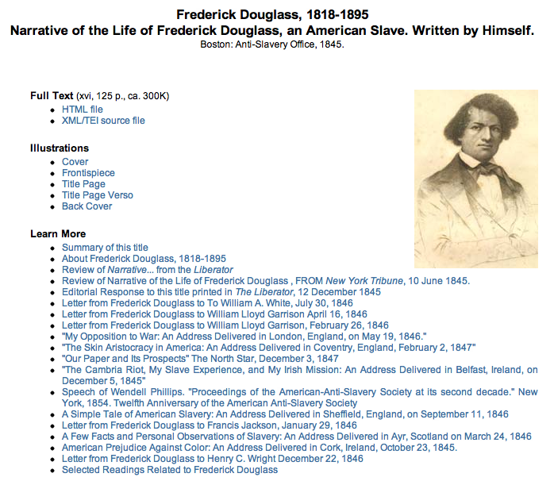
Added value through partnerships
Notes:
Two brief examples of other kinds of sustainability, related to adding value to collection objects.
LEARN NC – lesson plans
Working w/ faculty for interpretative aspects
User clicks on VAC pages make up more than 10% of the clicks

Slide 14
What types of services?
Faculty outreach – research and teaching
Training – local systems and external technology
Data management consulting
Institutional repository efforts
Project planning/management
Bringing the content and the tech together
Notes:
This is a transition for us. We’re still working on defining it.
It’s about doing new things, but it’s also about recasting some of our current activities in a new light. We’re still doing digitization. Re-cast this as a service, just start thinking that way.
My unit isn’t doing all of these right now – they’re all somewhere in the library, to some degree. Skills don’t have to be located in just one department.
How to grow supporting more and more projects? Visits to classes, user accounts, maintain more and more interactions. Don’t have a solution to this yet.

Slide 15
THE PROCESS
Basic premise: Encourage planning, allow possible initiatives to be compared to one another, provide a path for ideas to reach fruition, ensure we can commit the resources necessary to succeed with those initiatives we do prioritize.
Notes:
Encourage planning,
allow possible initiatives to be compared to one another,
provide a path for ideas to reach fruition,
ensure we can commit the resources necessary to succeed with those initiatives we do prioritize.

Slide 16
It’s not enough to have a good idea.
Notes:
Our Library Technology Council was struggling allocating technology resources. Good proposals, unclear implementation plans, no way to balance them against one another.
Need culture of cultivating ideas, get many involved in planning/implementing. Leadership, wide perspective on the part of the proposer, engagement from technical staff, all willing to negotiate, compromise, and see the larger picture.
We don’t have this yet at UNC. So how do we get there?
Lots of discussion. Clear direction, priorities.
But we also attempted in one way to force the issue.

Slide 17
Require full LTC review
Receive proposal
Post proposal for CDLA/Systems/LTC review
Assign CDLA facilitator
Identify stakeholders
Project/workflow/time analysis
Preliminary decision on proposal disposition
Report to LTC
Compare required resources to available resources
Absorb as part of non-project work
Approve and proceed immediately
Develop basic project plan/timeline
Estimate of required resources
Candidate for fast-track approval
Resources available
Fast-track approval
Resources not available
Final decision on proposal disposition
Resources become available before next LTC review
Place in holding queue for priority if resource availability changes
Yes
No
Require full LTC review
LTC semiannual review
Report to LTC
Develop full project proposal/timeline
General estimate of required resources
Notes:
This is our new process, version 1.0
“Library Technology Council Proposal Submission, Review, and Approval Process”
Explain what LTC is
Goal: transparency, planning, not too slow
Premise: set aside some resources for “projects”. Proposed projects clearly state how many resources they need.
For all tech, not just dig coll
It’s formal.
Submit any time. For big initiatives, twice-yearly decisions.
Responsible, allows prioritization. But not nimble.
Don’t need to go into the details. But review some notable features:
(next slide)

Slide 18
Require full LTC review
Receive proposal
Post proposal for CDLA/Systems/LTC review
Assign CDLA facilitator
Identify stakeholders
Project/workflow/time analysis
Preliminary decision on proposal disposition
Report to LTC
Compare required resources to available resources
Absorb as part of non-project work
Approve and proceed immediately
Develop basic project plan/timeline
Estimate of required resources
Candidate for fast-track approval
Resources available
Fast-track approval
For some initiatives, allow “fast track” approval.
Resources not available
Final decision on proposal disposition
Resources become available before next LTC review
Place in holding queue for priority if resource availability changes
Yes
No
Require full LTC review
LTC semiannual review
Report to LTC
Develop full project proposal/timeline
General estimate of required resources
Notes:
Administrators explicitly wanted a mechanism to compare possible initiatives against one another.
But can move more quickly in some cases.
Basic premise: Set aside some resources that can be used for initiatives as they come up.
Our criteria:
Something we already know how to do
Doesn’t take too many resources

Slide 19
Require full LTC review
Receive proposal
Post proposal for CDLA/Systems/LTC review
Assign CDLA facilitator
Identify stakeholders
Project/workflow/time analysis
Preliminary decision on proposal disposition
Report to LTC
Compare required resources to available resources
Absorb as part of non-project work
Approve and proceed immediately
Develop basic project plan/timeline
Estimate of required resources
Candidate for fast-track approval
Resources available
Fast-track approval
Resources not available
Develop a formal project plan.
Final decision on proposal disposition
Resources become available before next LTC review
Place in holding queue for priority if resource availability changes
Yes
No
Require full LTC review
LTC semiannual review
Report to LTC
Develop full project proposal/timeline
General estimate of required resources
Notes:
We have two different templates for fast-tracked and full review work.
Project plan templates have the usual features:
Justification
User impact
Assessment plan
Timeline/resources
Developed by a team, including both content and technical staff.
Forces planning. But is bureaucracy.
Goal is to use this as a valuable planning tool, not be seen as a barrier.
Note traditional project management approach. More on this later.

Slide 20
Require full LTC review
Receive proposal
Post proposal for CDLA/Systems/LTC review
Assign CDLA facilitator
Identify stakeholders
Project/workflow/time analysis
Preliminary decision on proposal disposition
Report to LTC
Compare required resources to available resources
Absorb as part of non-project work
“Facilitator” from the Carolina Digital Library and Archives
Approve and proceed immediately
Develop basic project plan/timeline
Estimate of required resources
Candidate for fast-track approval
Resources available
Fast-track approval
Resources not available
Final decision on proposal disposition
Resources become available before next LTC review
Place in holding queue for priority if resource availability changes
Yes
No
Require full LTC review
LTC semiannual review
Report to LTC
Develop full project proposal/timeline
General estimate of required resources
Notes:
Facilitator’s role:
Assist communication between content and tech staff
Knowledge of technical aspects – what we’re already set up to do, what our next infrastructure priorities are, and what’s out there as a possibility
Help through logistics of process
Build skills in project planning among library staff
This is a new CDLA service

Slide 21
Require full LTC review
Receive proposal
Post proposal for CDLA/Systems/LTC review
Assign CDLA facilitator
Identify stakeholders
Project/workflow/time analysis
Preliminary decision on proposal disposition
Report to LTC
Compare required resources to available resources
Absorb as part of non-project work
Approve and proceed immediately
Develop basic project plan/timeline
Estimate of required resources
Candidate for fast-track approval
Resources available
Fast-track approval
Resources not available
Final decision on proposal disposition
Resources become available before next LTC review
Place in holding queue for priority if resource availability changes
Yes
No
Require full LTC review
LTC semiannual review
Report to LTC
Develop full project proposal/timeline
General estimate of required resources
Notes:
Announced late fall.
All proposals received by Jan 15 were in this round of review.
8 processed as fast-track.
10 processed as full review. (Note some uncertainty between the two tracks.)
Decisions finalized last Thursday, announced today.

Slide 22
Role of assessment
Assessment is a current UNC Library priority
New (30%) Assessment Coordinator
Identified as a Library Technology Council priority for activities through end of 2012
Project plans required an assessment component
The assessment plans were pretty basic
Formal assessment of the project proposal process underway
Notes:
We’re attempting to practice what we preach.
Assessment of process:
Surveyed proposers/stakeholders
Focus group w/ cdla facilitators
Focus group w/ Library Systems staff (stakeholders)
Focus group w/ LTC
Expect changes as a result

Slide 23
What happened in this review cycle
We approved everything
All proposals submitted at once
Some proposals were able to move forward (relatively) quickly as fast-tracked
Notes:
We had the resources to approve everything! This was definitely a surprise.
Good outcome: data to reduce fear, uncertainty.
But should we have approved everything? What’s the role of resources vs. stated priorities?
Deadlines really influenced timing/pace of submission. This is definitely not what we want.
Just because it’s new and misunderstood? Or a fundamental part of human nature re: deadlines?
Fast track approvals weren’t fast enough. Just growing pains?

Slide 24
What we’ve learned (so far)
Administrators happy with the planning done; see progress; happy to issue approvals
Proposers view process as too burdensome
Current fast-track vs. full review setup has holes
Push more justification to the proposal stage
Planning phase isn’t enough for technical decisions in all cases
We need more assessment training
Facilitating proposals is a lot of work!

Slide 25
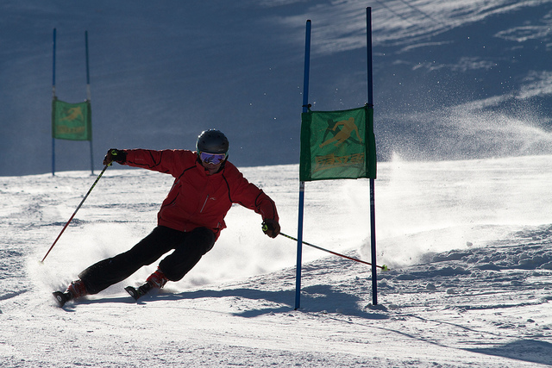
What about agility?
Photo by radloff. http://www.flickr.com/photos/radloff/6708510227/
Notes:
Those of you who know the literature on agile software development and agile project management will likely have seen in this process many of the weaknesses of traditional project management approaches that agile approaches provide an alternative to. We realize this,
Some challenges:
Need agility across projects, not just within an individual one
We’re not just planning software development projects
We’re not (currently) an agile organization. We probably never will be.
But there are some opportunities:
This could be a way to take some steps towards agile. There’s value in that.
Get proposers and tech staff more invested in the work
Clear need for iteration in our process

Slide 26
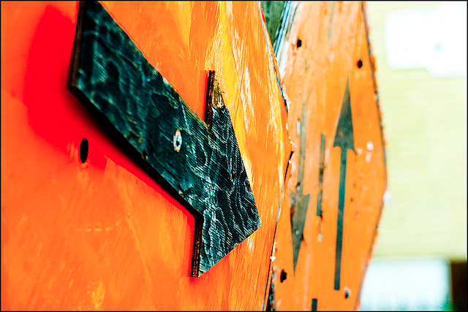
Next steps towards sustainability
Photo by Trevor Haldenby. http://www.flickr.com/photos/trevorh/491898939/
Notes:
While maintaining growth and innovation
Sunsetting projects
Sunsetting technologies
Clear expectations – boundaries without negativity
Re-evaluate tech/initiatives we support after a time, without too much work or oversight
Cuture of experimentation – give room, don’t assume next step is a certainty
Promote the wide view
Iterate our outlook, plans, and processes

Slide 27
Thank you!
jennriley@unc.edu
These slides: http://www.lib.unc.edu/users/jlriley/presentations/cni12s/rileySustainability.pptx

