Slide 1
Introduction to (Music) Metadata
Jenn Riley
Metadata Librarian
IU Digital Library Program

Slide 2
What we’re going to cover
A lot! Get ready for a whirlwind tour.
For many different metadata formats
Brief introduction
What it is for
When is a good time to use it
Usually an example
Focus on what digital music libraries need
We’ll focus mostly on standards cultural heritage institutions use, and less on “industry” standards
Let’s interact – ask questions, comment as we go
At the end of class we’ll look at some music search systems

Slide 3
Many definitions of metadata
“Data about data”
“Structured information about an information resource of any media type or format.” (Caplan)
“Structured information that describes, explains, locates, or otherwise makes it easier to retrieve, use, or manage an information resource.” (NISO)
…

Slide 4
More definition, in libraries
Structure
Control
Origin
Machine-generated
Human-generated
The difference between data, metadata, and meta-metadata is often one of perspective

Slide 5
Some uses of metadata
By information specialists
Describing “non-traditional” materials
Cataloging Web sites
Navigating within digital objects
Managing digital objects over the long term
By novices
Preparing Web sites for search engines
Depositing materials into an institutional repository
Managing citation lists
iTunes
Tagging – flickr, del.icio.us, etc.
LibraryThing

Slide 6
Metadata and cataloging
Depends on what you mean by:
metadata, and
cataloging!
But, in general:
Metadata is broader in scope than cataloging
Much metadata creation takes place outside of libraries
Good metadata practitioners use key cataloging principles in non-MARC environments
Metadata created for many different types of materials
Metadata is NOT only for Internet resources!

Slide 7
XML is often used for expressing metadata
XML = eXtensible Markup Language
“Meta-language” for defining markup languages for specific purposes
Many metadata formats cultural heritage institutions use are encoded in XML
Specific XML languages can be defined in several ways:
DTD
W3C XML Schema
RELAX NG

Slide 8
XML terminology
Element
Also called a “tag”
Element name surrounded by brackets, e.g., <titleInfo>
“Opens” <titleInfo> and “closes” </titleInfo>
Attribute
Name/value pair that applies to the element and its content
Included within the text in brackets, e.g., <titleInfo type="alternative">

Slide 9
Element content
(What’s between the open and close tags)
Text
<title>Spring and fall</title>
Other elements
<titleInfo> <title>Spring and fall</title> <subTitle>a tone poem</subTitle>
</titleInfo>
Both (mixed content)
<something>some text, <otherthing>other text</otherthing></something>
Empty elements
<tableOfContents xlink:href= "http://www.loc.gov/catdir/toc/99176484.html"/>

Slide 10
Types of metadata
Descriptive metadata
Administrative metadata
Technical metadata
Preservation metadata
Rights metadata
Structural metadata
Markup languages

Slide 11
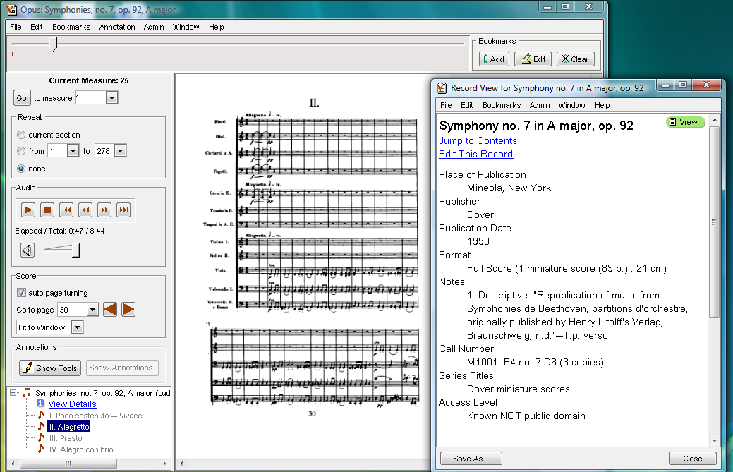
How metadata is used

Slide 12
Levels of control
Three general types of standards, as viewed by libraries
Data structure standards (e.g., MARC, Dublin core)
Data content standards (e.g., AACR2r, RDA)
Controlled vocabularies (e.g., LCSH)
Mix and match to meet your needs
Dividing lines not always clear, however
We’ll be talking about data structure standards today

Slide 13
Descriptive metadata
Purpose
Discovery
Description to support use and interpretation
Some common general schemas
MARC
MARCXML
MODS
Dublin Core
LOTS of domain-specific schemas

Slide 14
MARC
Implementation of ISO 2709, ANSI/NISO Z39.2
Originally released in the late 1960s
MARC21 is the format used in the U.S.
Other areas have other ISO 2709 implementations, e.g., UNIMARC
“Format integration” in the first half of the 1990s
Typically used with AACR2, ISBD punctuation, and LCSH, but this is not a requirement
Use when you want integration of content into the OPAC interface

Slide 15
MARC example
This is actually a “human-readable” view of this record, not its native storage format
Notice
3-digit data fields
Subfields introduced by $ (also sometimes rendered as | or ‡)
Indicators providing information about how to interpret the data in the field
Mixture of machine-readable and human-readable data

Slide 16
MARCXML
Exact rendering of MARC in XML
Generally used as interim step between MARC and some other XML-based format
Not intended to be generated directly by people
Notice in the example
Verbose syntax (only a small portion of the record is represented here)

Slide 17
Metadata Object Description Schema (MODS)
Developed and maintained by the LC Network Development and MARC Standards Office
Inspired by MARC, but not equivalent
Intended to be useful to a wider audience than MARC
Still a “bibliographic” focus
Use when you want a library-type approach but more interoperability than MARC and the benefits of XML

Slide 18
MODS example
Textual element names
General MARC inspiration
AACR2 used in this example, but not required by MODS
Fairly extensive scope
But still “library-ish”

Slide 19
Dublin Core
Perhaps the most misunderstood metadata standard!
Dublin Core Metadata Element Set (DCMES)
ANSI/NISO Z39.85, ISO 15836
No element required
All elements repeatable
1:1 principle
Abstract Model is current focus

Slide 20
Dublin Core Metadata Element Set
Unqualified – 15 elements
This is the format most think of as “Dublin Core”
Qualified
Additional elements
Element refinements
Encoding schemes (vocabulary and syntax)
All qualifiers must follow “dumb-down” principle

Slide 21
Uses of DCMES
“Core” across all knowledge domains
Unqualified DC required for sharing metadata via the Open Archives Initiative
Useful for cross-collection searching
QDC occasionally used as a native metadata format
CONTENTdm
DSpace

Slide 22
Dublin Core examples
Relative simpleness of the formats
QDC allows the specification of source vocabulary, more specific element meanings
These records generated via standard mappings from MARC
Obviously the mappings need some work
But that doesn’t mean the target formats aren’t useful!
Remember, every format has its purpose

Slide 23
Music descriptive metadata

Slide 24
Music metadata hasn’t evolved on its own
No discipline-generated format has emerged
Do we need one?
Industry is a strong influence in this community
“Music” is almost impossibly diverse
Different cultures, traditions
Different formats (sound, notation, visual + audio)
Quickly changing environment

Slide 25
Some music metadata structure formats
Variations2 – Indiana University
Probado – Bavarian State Library
Music Ontology – Music Information Retrieval community
ID3 tags - Industry
Overall, only very specialized applications choose these over a format-neutral option.

Slide 26
MPEG-7
“Multimedia Content Description Interface”
ISO/IEC standard
From the Moving Picture Experts Group, which is behind the MPEG-1 and MPEG-2 multimedia content formats, and the MPEG-21 Multimedia Framework
Descriptions can be expressed in XML or compressed binary form

Slide 27
MPEG-7: Framework rather than element set
“Description Definition Language”
Based on W3C XML Schema
Defines “description schemes”
Pre-defined description schemes for video and audio
Focus is more on “low-level” descriptors than library-style bibliographic information
Would preserve MPEG-7 information when generated by an editing application
Unlikely a library would choose it as a format for descriptive metadata to support discovery

Slide 28
MPEG-7 scope
Wide scope – intended to cover descriptive, technical, rights, use, etc., information
Many media formats
Still pictures
Graphics
3D models
Audio
Speech
Video
“Scenarios” combining these elements
Note technical details of the audio waveform in the example

Slide 29
Public Broadcasting Core (PB Core)
Development funded by the Corporation for Public Broadcasting
Data to support the creation, management, and discovery of “media items”
4 classes
IntellectualContent
IntellectualProperty
Instantiation
Extensions
Likely the best choice for broadcasting archives

Slide 30
PB Core example
Common descriptive information such as title, subject, genre
Audience level and rating
Rights information
Separates “instantiation” from intellectual content

Slide 31
Technical and administrative metadata for A/V materials

Slide 32
Metadata for Images in XML (MIX)
Implementation in XML of ANSI/NISO Z39.87 data dictionary
Maintained by the Library of Congress Network Development and MARC Standards Office
Technical information needed to render the image and data on how it was created
Use for any still image format; most can be generated automatically
Note features such as compression level, pixel dimensions, format-specific data, and bit rate

Slide 33
AES Core Audio
Currently under development by the Audio Engineering Society, not yet in general release
Divides audio into face->region->stream
Can be used for both analog and digital audio
Use for any audio file; most can be generated automatically
Expectation is that most audio editing software will be able to generate this format
Note duration, sample rate, channel assignments

Slide 34
LC A/V Prototyping Project Audio (Source) Data Dictionary
Developed in 2003
Never implemented in a production environment
Use AES Core Audio instead when you can
This is probably a reasonable choice in the meantime
Note encoding, duration, sample size, channel information

Slide 35
AES Process History Metadata
Currently under development by the Audio Engineering Society, not yet in general release
Records “processing events”
Detailed information about device settings, signal patches
Used to support the digital preservation process
Use for any audio file; most can be generated automatically
Expectation is that most audio editing software will be able to generate this format
Note device data, input/output channels, patch list

Slide 36
Structural metadata

Slide 37
Metadata Encoding and Transmission Standard (METS)
“Wrapper” to package many types of metadata together for a resource
Structural metadata is its heart
Expectation is that METS documents will be generated programmatically
Not many METS generation tools out there, though
Often used for exchange of data between repositories, and for ingest into and export out of a repository

Slide 38
METS example
This example shows an “audio preservation package”
Collection-level descriptive metadata in MARCXML
AES Core Audio technical metadata for analog source and various digitized versions
Audio decision lists
AES Process History
Audio and ADL files
Structural information
Relationships between different versions
Milestones on the audio timeline

Slide 39
SMPTE Material eXchange Format (MXF)
Actually a family of standards
Wrapper for metadata and media files (“essence”)
Industry-driven format designed for interoperability between devices
Low-level feature information
Generated by media editing software
Example shows part of a header and references to essence files

Slide 40
Synchronized Multimedia Integration Language (SMIL)
From the W3C, the body behind HTML and XML
For multimedia presentations
Embedded media, transitions, timing
Most media players support SMIL
Note examples showing images in sequence and in parallel

Slide 41
AES-31-3 Audio Decision List
Used by editing software to record edits made to audio files
Text-based format that looks like XML in places
Documents how files are stitched together to create the output
Uses a common “destination timeline” for all files
Non-standard extension for “markers” in WaveLab
Note in/out fade, “cuelist”

Slide 42
Music markup languages

Slide 43
Content, not “metadata”
For encoding musical notation itself - the full content
Tend to include “header” with some descriptive metadata
Currently, two primary choices
MusicXML
Focus on industry, notation software
Music Encoding Initiative (MEI)
Inspired by the Text Encoding Initiative (TEI)
Ignore Standard Music Description Language (SMDL)

Slide 44
Implementation scenarios

Slide 45
Scenario 1: Audio course reserves
Discovery
MARC/AACR2 records in OPAC
Course reserves module with descriptive data extracted from MARC records
Link from discovery system launches media player
Delivery
Locally-managed media streaming server
(Optional) SMIL for navigation

Slide 46
Scenario 2: Digital music library
High-end, specialized, online environment for music in a variety of formats
Work-based metadata model such as Variations2 optimized for music discovery
Descriptive metadata records persistently link to media files in tools that facilitate use of the content
METS-based structural metadata for navigation within and between media files
Various forms of technical and administrative metadata for long-term preservation of media files

Slide 47
Scenario 3: Broadcast archive
Focus on management of media; discovery only for staff and not for end-users
PB Core as base metadata
High-end media editing software generates AES, MXF, other industry standard technical metadata
METS wrapper for connecting PB Core data to structural and technical metadata for ingest into preservation repository

Slide 48
Scenario 4: Online special collections
Discovery
MODS for item-level description of a variety of formats (manuscript music, letters, photographs, oral histories)
Delivery
METS for structural data for multi-page objects
Online page-turning interface
PDF download
Commonly used software such as CONTENTdm does much of this in its own quirky way

Slide 49
Let’s look at some search systems
IU WorldCat
IUCAT
Variations2
iTunes
All Music Guide
Amazon.com
What are we looking for?
Search options
Types of music represented, and how well
Information on results page
Individual record display
What works? And what doesn’t?

Slide 50
Thank you!
jenlrile@indiana.edu
These presentation slides: http://www.dlib.indiana.edu/~jenlrile/presentations/slis/ 10fall/s655.pptx
Workshop handout: http://www.dlib.indiana.edu/~jenlrile/presentations/slis/ 10fall/handout.pdf

