Slide 1
Introduction to Metadata for Cultural Heritage Organizations
Jenn Riley
Metadata Librarian
Indiana University Digital Library Program

Slide 2
Many definitions of metadata
“Data about data”
“Structured information about an information resource of any media type or format.” (Caplan)
“Structured information that describes, explains, locates, or otherwise makes it easier to retrieve, use, or manage an information resource.” (NISO)
“Metadata is constructed, constructive, and actionable.” (Coyle)
…

Slide 3
Refining a definition
Other characteristics
Structure
Control
Origin
Machine-generated
Human-generated
The difference between data, metadata, and meta-metadata is often one of perspective

Slide 4
Some uses of metadata
By information specialists
Describing non-traditional materials
Cataloging Web sites
Navigating within digital objects
Managing digital objects over the long term
By everyone!
Preparing Web sites for search engines
Depositing research into an institutional repository
Managing citation lists
iTunes
Tagging: flickr, del.icio.us, etc.
LibraryThing
Notes:
Who’s used LibraryThing?

Slide 5
Metadata and cataloging
Depends on what you mean by:
metadata, and
cataloging!
But, in general:
Metadata is broader in scope than cataloging
Much metadata creation takes place outside of libraries
Good metadata practitioners use fundamental cataloging principles in non-MARC environments
Metadata created for many different types of materials
Metadata is NOT only for Internet resources!

Slide 6
Metadata in digital library projects
Searching
Browsing
Display for users
Interoperability
Management of digital objects
Preservation
Navigation
Enhancing content

Slide 7
Some types of metadata
Type | Use
Descriptive metadata | Searching Browsing Display Interoperability
Technical metadata | Interoperability Digital object management Preservation
Preservation metadata | Interoperability Preservation
Rights metadata | Interoperability Digital object management
Structural metadata | Navigation
Markup languages | Navigation Enhancing content

Slide 8
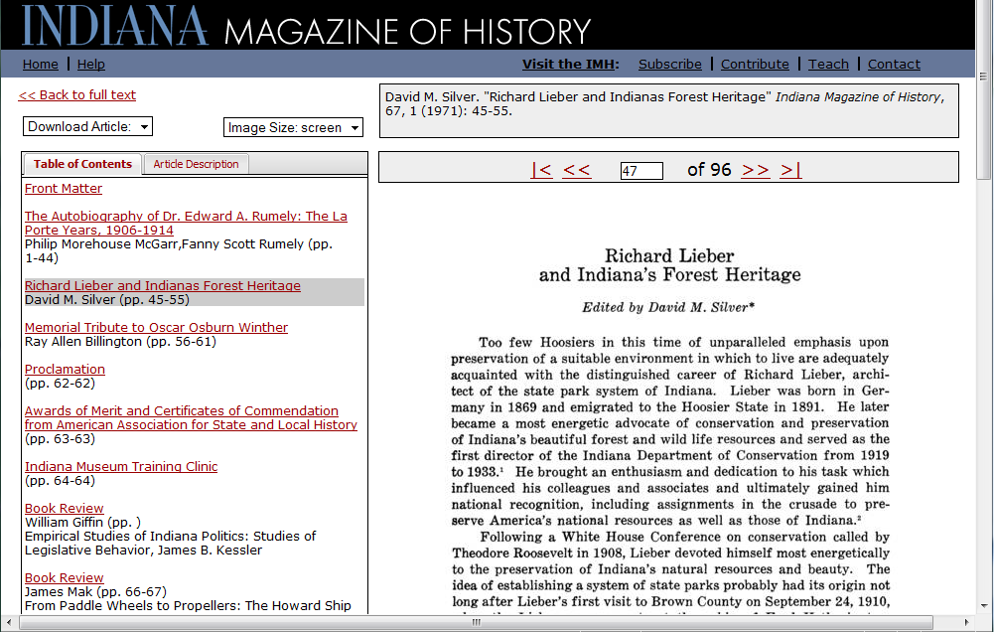
How metadata is used

Slide 9
Creating descriptive metadata
Digital library content management systems
CONTENTdm
ExLibris Digitool
Greenstone
DSpace
Library catalogs
Spreadsheets & databases
Directly in XML (generally not recommended)
Notes:
Who uses contentDM? Dspace? Others?

Slide 10
Creating other types of metadata
Technical
Generated by and stored in content management system
Stored in separate Excel spreadsheet
Structural
Created and stored in content management system
METS XML
GIS
Using specialized software
Content markup
In XML

Slide 11
Descriptive metadata
Purpose
Discovery
Description to support use and interpretation
Some common general schemas
Dublin Core (simple and qualified)
MARC
MARCXML
MODS
LOTS of domain-specific schemas

Slide 12
Levels of control
Data structure standards (e.g., MARC, MODS)
Data content standards (e.g., AACR2r, RDA)
Encoding schemes
Vocabulary (a.k.a. controlled vocabularies)
Syntax
High-level models (e.g., FRBR, DCAM)
We’ll focus on structure standards today

Slide 13
Simple Dublin Core (DC)
15-element metadata structure standard
National and international standard
2001: Released as ANSI/NISO Z39.85
2003: Released as ISO 15836
Maintained by the Dublin Core Metadata Initiative
“Core” across all knowledge domains
No element required
All elements repeatable
Simple DC required for sharing metadata via the Open Archives Initiative Protocol for Metadata Harvesting

Slide 14
Content/value standards for DC
None required
No reason you can’t use AACR2!
Some elements recommend a content or value standard as a best practice
Coverage
Date
Format
Language
Identifier
Relation
Source
Subject
Type

Slide 15
Some limitations of DC
Can’t indicate a main title vs. other subordinate titles
No method for specifying creator roles
W3CDTF format can’t indicate date ranges or uncertainty
Can’t by itself provide robust record relationships

Slide 16
Good times to use DC
Cross-collection searching
Cross-domain discovery
Metadata sharing
Describing some types of simple resources
Metadata creation by novices

Slide 17
 | DC [record] | QDC [record] | MARC [record] | MARCXML [record] | MODS [record]
Record format | XML RDF (X)HTML
Field labels | Text
Reliance on AACR | None
Common method of creation | By novices, by specialists, and by derivation

Slide 18
Qualified Dublin Core (QDC)
Adds some increased specificity to Unqualified Dublin Core
Additional elements
Element refinements
Encoding schemes (vocabulary and syntax)
Defined by DMCI Terms
Most implementations expand beyond official qualifiers
Same encodings as DC
Same content/value standards as DC
Notes:
Extensibility: via Application Profiles and local qualifiers. Local qualifiers maybe not kosher but there are no metadata police. Usually.

Slide 19
Limitations of QDC
Widely misunderstood
No method for specifying creator roles
W3CDTF format can’t indicate date ranges or uncertainty
XML encoding has never been very stable; few implementations conform to newest DCMI proposed recommendation

Slide 20
Best times to use QDC
More specificity needed than simple DC, but not a fundamentally different approach to description
Want to share DC with others, but need a few extensions for your local environment
Describing some types of simple resources
Metadata creation by novices

Slide 21
 | DC [record] | QDC [record] | MARC [record] | MARCXML [record] | MODS [record]
Record format | XML RDF (X)HTML | XML RDF (X)HTML
Field labels | Text | Text
Reliance on AACR | None | None
Common method of creation | By novices, by specialists, and by derivation | By novices, by specialists, and by derivation

Slide 22
MAchine Readable Cataloging (MARC)
Format for records in library catalogs
Used for library metadata since 1960s
Adopted as national standard in 1971
Adopted as international standard in 1973
Actually a family of MARC standards throughout the world
U.S. & Canada use MARC21
Field names
Numeric fields
Alphanumeric subfields
Notes:
Who here is a MARC cataloger?

Slide 23
Content/value standards for MARC
None required by the format itself
But US record creation practice relies heavily on:
AACR2r
ISBD
LCNAF
LCSH

Slide 24
Limitations of MARC
Use of all its potential is time-consuming
OPACs don’t make full use of all possible data
OPACs virtually the only systems to use MARC data
Requires highly-trained staff to create
Local practice differs greatly

Slide 25
Good times to use MARC
Integration with other records in OPAC
Resources are like those traditionally found in library catalogs
Maximum compatibility with other libraries is needed
Have expert catalogers for metadata creation

Slide 26
 | DC [record] | QDC [record] | MARC [record] | MARCXML [record] | MODS [record]
Record format | XML RDF (X)HTML | XML RDF (X)HTML | ISO 2709 [ANSI Z39.2]
Field labels | Text | Text | Numeric
Reliance on AACR | None | None | Strong
Common method of creation | By novices, by specialists, and by derivation | By novices, by specialists, and by derivation | By specialists

Slide 27
MARC in XML (MARCXML)
Copies the exact structure of MARC21 in an XML syntax
Numeric fields
Alphanumeric subfields
Implicit assumption that content/value standards are the same as in MARC

Slide 28
Limitations of MARCXML
Not appropriate for direct data entry
Extremely verbose syntax
Full content validation requires tools external to XML Schema conformance

Slide 29
Best times to use MARCXML
As a transition format between a MARC record and another XML-encoded metadata format
Materials lend themselves to library-type description
Need more robustness than DC offers
Want XML representation to store within larger digital object but need lossless conversion to MARC

Slide 30
 | DC [record] | QDC [record] | MARC [record] | MARCXML [record] | MODS [record]
Record format | XML RDF (X)HTML | XML RDF (X)HTML | ISO 2709 [ANSI Z39.2] | XML
Field labels | Text | Text | Numeric | Numeric
Reliance on AACR | None | None | Strong | Strong
Common method of creation | By novices, by specialists, and by derivation | By novices, by specialists, and by derivation | By specialists | By derivation

Slide 31
Metadata Object Description Schema (MODS)
Developed and managed by the Library of Congress Network Development and MARC Standards Office
For encoding bibliographic information
Influenced by MARC, but not equivalent
Usable for any format of materials
First released for trial use June 2002
MODS 3.4 to be released soon

Slide 32
MODS differences from MARC
MODS is “MARC-like” but intended to be simpler
Textual tag names
Encoded in XML
Some specific changes
Some regrouping of elements
Removes some elements
Adds some elements

Slide 33
Content/value standards for MODS
Many elements indicate a given content/value standard should be used
Generally follows MARC/AACR2/ISBD conventions
But not all enforced by the MODS XML schema
Authority attribute available on many elements

Slide 34
Limitations of MODS
No lossless round-trip conversion from and to MARC
Still largely implemented by library community only
Some semantics of MARC lost

Slide 35
Good times to use MODS
Materials lend themselves to library-type description
Want to reach both library and non-library audiences
Need more robustness than DC offers
Want XML representation to store within larger digital object

Slide 36
 | DC [record] | QDC [record] | MARC [record] | MARCXML [record] | MODS [record]
Record format | XML RDF (X)HTML | XML RDF (X)HTML | ISO 2709 [ANSI Z39.2] | XML | XML
Field labels | Text | Text | Numeric | Numeric | Text
Reliance on AACR | None | None | Strong | Strong | Implied
Common method of creation | By novices, by specialists, and by derivation | By novices, by specialists, and by derivation | By specialists | By derivation | By specialists and by derivation

Slide 37
Visual Resources Association (VRA) Core
Grew out of the work by a professional association
Separates Work from Image
Library focus
Inspiration from Dublin Core
Version 4.0 exists in “restricted” and “unrestricted” versions

Slide 38
Categories for the Description of Works of Art (CDWA) Lite
Reduced version of the Categories for the Description of Works of Art (512 categories)
From J. Paul Getty Trust
Museum focus
Conceived for record sharing

Slide 39
Structure standards for learning materials
Gateway to Educational Materials (GEM)
From the U.S. Department of Education
Based on Qualified Dublin Core
Adds elements for instructional level, instructional method, etc.
“GEM's goal is to improve the organization and accessibility of the substantial collections of materials that are already available on various federal, state, university, non-profit, and commercial Internet sites.”*
IEEE Learning Object Metadata (LOM)
Elements for technical and descriptive metadata about learning resources
* From <http://www.thegateway.org/about/documentation/schemas>

Slide 40
Encoded Archival Description (EAD)
Maintained by the Society for American Archivists
Markup language for archival finding aids
Designed to accommodate multi-level description
Requires specialized search engine
Delivery requires specialized software or offline conversion to HTML

Slide 41
Text Encoding Initiative (TEI)
Best Practices for TEI in Libraries
For encoding full texts of documents
Literary texts
Letters
…etc.
Requires specialized search engine
Delivery requires specialized software or offline conversion to HTML

Slide 42
How do I pick standards? (1)
Institution
Nature of holding institution
Resources available for metadata creation
What others in the community are doing
Capabilities of your delivery software
The standard
Purpose
Structure
Context
History

Slide 43
How do I pick standards? (2)
Materials
Genre
Format
Likely audiences
What metadata already exists for these materials
Project goals
Robustness needed for the given materials and users
Describing multiple versions
Mechanisms for providing relationships between records
Plan for interoperability, including repeatability of elements

Slide 44
Assessing materials for ease of metadata creation
Number of items?
Homogeneity of items?
Foreign language?
Published or unpublished?
Specialist needed?
How much information is known?
Any existing metadata?

Slide 45
Assessing currently existing metadata
Machine-readable?
Divided into fields?
What format?
What content standards?
Complete?

Slide 46
Assessing software capabilities
Are there templates for standard metadata formats?
Can you add/remove fields to a template?
Can you create new templates?
Can you add additional clarifying information without creating a separate field?
Personal vs. corporate names
Subject vocabulary used
Is there an XML export? Does it produce valid records?
Notes:
What software packages are you looking at, at your institution?

Slide 47
Beyond descriptive metadata
Technical metadata
Preservation metadata
Rights metadata
Structural metadata

Slide 48
Technical metadata
For recording technical aspects of digital objects
For long-term maintenance of data
Migration
Emulation
Much can be generate automatically, but not all
Some examples:
NISO Z39.87: Data Dictionary – Technical Metadata for Digital Still Images & MIX
Schema for Technical Metadata for Text
Forthcoming standard for audio from the Audio Engineering Society
Notes:
Anyone actively collect technical metadata?

Slide 49
Image technical metadata
Might include:
Color space
Bit depth
Byte order
Compression scheme
Camera settings
Operator name

Slide 50
Text technical metadata
Might include:
Character set
Byte order
Font/script
Language

Slide 51
Audio technical metadata
Might include:
Byte order
Checksum
Sample rate
Duration
Number of channels

Slide 52
Video technical metadata
Might include:
Bits per sample
Calibration information
Sample format
Signal format

Slide 53
Preservation metadata
The set of everything you need to know to preserve digital objects over the long term
Information that supports and documents the digital preservation process
Includes technical metadata but also other elements
Covers elements such as checksums, creation environment, and change history
PREMIS is the prevailing model

Slide 54
Rights metadata
Machine- or human-readable indications of rights information for a resource
Can be used to determine if a user can access a resource
Can indicate rights holder of a resource for payment purposes
Some current schemas
METS rights
XrML
ODRL

Slide 55
Structural metadata
For creating a logical structure between digital objects
Multiple copies/versions of same item
Multiple pages within item
Multiple sizes of each page
Meaningful groups of content
Noting points of interest within a resource
Often handled transparently by a delivery system
METS is most heavily used in libraries

Slide 56
Why you should care about these standards
You will migrate from your current system to another, probably in the next few years
File formats become obsolete
We have too many interesting collections to have to re-do work we’ve already done
Standards promote interoperability

Slide 57
Building “Good digital collections”*
Interoperable – with the important goal of cross-collection searching
Persistent – reliably accessible
Re-usable – repositories of digital objects that can be used for multiple purposes
Good metadata promotes good digital collections.
*Institute for Museum and Library Services. A Framework of Guidance for Building Good Digital Collections. Washington, D.C.: Institute for Museum and Library Services, 3rd edition, December 2007. http://www.niso.org/publications/rp/framework3.pdf

Slide 58
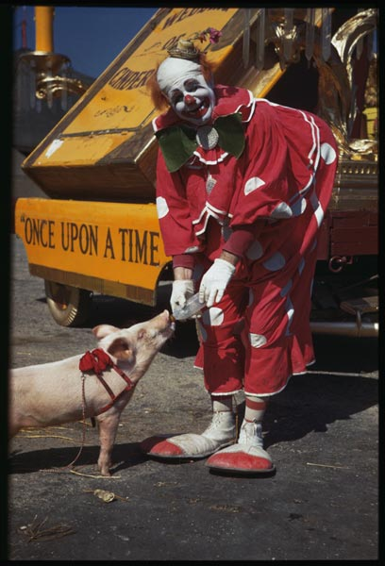
Where your metadata can go
?????
Collection Registries
Photograph from Indiana University Charles W. Cushman Collection

Slide 59
Why share metadata?
Benefits to users
One-stop searching
Aggregation of subject-specific resources
Benefits to institutions
Increased exposure for collections
Broader user base
Bringing together of distributed collections
Don’t expect users will know about your collection or remember to visit it.

Slide 60
Sharing your metadata
Harvesting
Collects metadata, processes it, and stores it locally to respond to user queries
Open Archives Initiative Protocol for Metadata Harvesting (OAI-PMH)
Federated searching
Transmits user queries to multiple destinations in real time
ILS vendors currently offering these products
Protocols used include
Z39.50
SRU

Slide 61
OAI-PMH
Intentionally designed to be simple
Data providers
Have metadata they want to share
“Expose” their metadata to be harvested
Simple DC required but supplemental formats allowed
Service providers
Harvest metadata from data providers
Provide searching of harvested metadata from multiple sources
Typically link back to holding institution
Can also provide other value-added services
Notes:
Anyone currently implement OAI-PMH? Through CONTENTdm?

Slide 62
Three possible architectures
Digital asset management system
QDC
MODS
Metadata creation module
OAI data provider module
Transformation
DC
MARCXML
Metadata creation system
Static Repository Gateway
OAI Harvester
Transformation
QDC
MODS
Metadata creation system
Stand-alone OAI data provider
Transformation
DC
MARCXML
Notes:
Who uses each of these models?

Slide 63
Sharing workflow
Plan
Transform
Choose standards for native metadata
Perform conceptual mapping
Create
Share
Assess
Who to share with?
Implement sharing protocol
See who is collecting your metadata
Perform technical mapping
Create metadata (thinking about shareability)
Communicate with aggregators
Review your metadata in aggregations
Choose shared metadata formats
Validate transformed metadata
Write metadata creation guidelines
Test shared metadata with protocol conformance tools

Slide 64
Before you share…
Check your metadata
Appropriate view?
Consistent?
Context provided?
Does the aggregator have what they need?
Documented?
Can a stranger tell you what the record describes?

Slide 65
The reality of sharing metadata
We can no longer afford to only think about our local users
Creating shareable metadata will require more work on your part
Creating shareable metadata will require our vendors to support (more) standards
Creating shareable metadata is no longer an option, it’s a requirement

Slide 66
Putting it all into practice
Develop written documentation
Develop a quality control workflow for metadata creation
Share your findings with others
Get better with every new online collection

Slide 67
Thank you!
For more information:
jenlrile@indiana.edu
Metadata librarians listserv: http://metadatalibrarians.monarchos.com/
These presentation slides: http://www.dlib.indiana.edu/~jenlrile/presentations/slis/10spring/s631/s631.pptx
My best advice:
Read
Talk to colleagues
Know WHY you are doing things the way you’re doing them

