Slide 1
Overview of EAD
Jenn Riley
Metadata Librarian
Digital Library Program

Slide 2
Basics of EAD
“Encoded Archival Description”
XML markup language for archival finding aids
Started at UC Berkeley in 1993, then continued development under Society of American Archivists
First stable version EAD 1.0, now EAD2002
SAA formed group for a revised version in February 2010; to be published August 2013

Slide 3
EAD as a markup language
Different than a metadata structure standard (MARC, MODS, Dublin Core)
Designed explicitly for multi-level description
Includes formatting mechanisms (lists, paragraphs, rendering information, etc.)
Documents it’s intended for have a less predictable structure than metadata structure standards expect
Tag features as they appear, rather than looking for data to fit into a specific field
But is still the primary source of descriptive metadata for archival collections

Slide 4
Multiple simultaneous descriptions
Collection-level record
Generally in MARC
Goal is to alert researchers to the presence of a collection and lead them to the…
Multi-level finding aid
Might be in Word, HTML, EAD
Goal is to help researchers understand the collection, and to help them decide which parts of it they wish to access
Item-level description
Not commonly used in archives
Might be in EAD, MODS, Dublin Core, etc.

Slide 5
Some useful EAD resources
EAD2002 Tag Library
EAD Application Guidelines (for EAD 1.0!)
RLG EAD Best Practice Guidelines

Slide 6
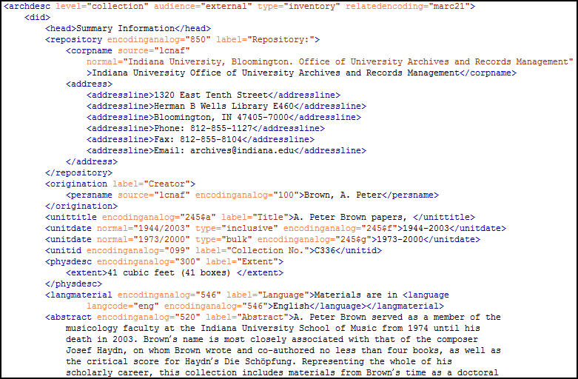
And here’s some EAD!

Slide 7
XML terminology
Element
Also called a “tag”
Element name surrounded by brackets, e.g., <unitdate>
“Opens” <unitdate> and “closes” </unitdate>
Attribute
Name/value pair that applies to the element and its content
Included within brackets, e.g., <unitdate type="bulk">
Value
What’s within an element, e.g. <tag>value</tag>

Slide 8
Elements must be nested
Called “parent” and “child”
YES: <scopecontent> <p>Papers of the Lewis family…</p> </scopecontent>
NO: <scopecontent> <p>Papers of the Lewis family…</scopecontent></p>

Slide 9
Using the EAD Tag Library
Description defines some attributes
May contain
May occur within
Attributes
Examples
Look to the Application Guidelines if something not defined

Slide 10
EAD is inherently flexible
EAD prescribes only a basic high-level structure
Most other elements available in multiple places
Classes of elements
Structural elements, e.g., archdesc, dsc
Content elements, e.g., controlaccess, scopecontent
Formatting elements, e.g., list, p

Slide 11
Basic EAD structure
<ead>
<eadheader />
<frontmatter />
<archdesc />
<dsc />
</ead>
We’ll encode a finding aid as we go.

Slide 12
<archdesc>
For the primary archival description of the collection, record group, or fonds
Some interesting attributes
level/otherlevel – from prescribed list
type – inventory, register, etc.
No prescribed order for subelements
No prescribed label for subelements

Slide 13
<did>
Appears at many levels of description
For main descriptive information
Primary subelements
<origination>/<persname|corpname|famname|name>
<unittitle>
<unitdate>
<physdesc>
<abstract>
<physloc>
<originalsloc>
<repository>
<unitid>
<langmaterial>
<note>

Slide 14
Other main <archdesc> subelements
<bioghist>
<scopecontent>
<arrangement>
<separatedmaterial>
<relatedmaterial>
<accessrestrict>
<accruals>
<acqinfo>
<altformavail>
<appraisal>
<custodhist>
<prefercite>
<processinfo>
<userestrict>
<relatedmaterial>
<separatedmaterial>
<otherfindaid>
<bibliography>
<odd>
<controlaccess>

Slide 15
You also might find useful…
Content
<head>
<name>
<title>
Formatting
<p>
<blockquote>
<list>

Slide 16
Intellectual structure: the <dsc>
<c> or <c01>…<c12>
Nested within each other to show hierarchy
Use them all in order, regardless of which level is being described
<c01> generally the series
<c02> …subseries
<c03> …file, etc.
Can use <c0x> for item as well

Slide 17
<c0x> attributes and subelements
level attribute
<did> subelement - includes unit title, id, unit dates, language, etc.
Other descriptive subelements
<scopecontent>
<arrangement>
<controlaccess>
<accessrestrict>
…and many more
Describe this component before opening its child

Slide 18
<eadheader> vs. <frontmatter>
Both <eadheader> and <frontmatter> describe the finding aid, not the collection
<eadheader> is structured information in a relatively predictable form and order
<frontmatter> similar in scope, but used to support the generation of title pages in legacy style
Many EAD implementers do not use <frontmatter>

Slide 19
Required <eadheader> elements
eadid
Unique ID for this finding aid
For attribute values, see RLG Best Practice
filedesc/titlestmt/titleproper
“Guide to the xxx Papers/Records”
“xxx Papers/Records, A Guide to the Collection”

Slide 20
<filedesc>
titlestmt - in addition to titleproper:
subtitle
author
editionstmt
publicationstmt
seriesstmt
notestmt
REMEMBER – this is data about the finding aid

Slide 21
That’s not remotely all!
Many, many, many more elements available
Use them when you need them
Look for balance between consistency and flexibility

Slide 22
For more information
jenlrile@indiana.edu
SAA EAD Workshops
EAD Listserv <http://www.loc.gov/ead/>
Start with 3 special issues of journals
American Archivist vol. 60: 3 (Summer 1997)
American Archivist vol. 60: 4 (Fall 1997)
Archives and Museum Informatics 12: 3-4 (1998)

